Slide 1

Introduction to
Xiaojia He
Jonathan Waring
CSCI 6360
Fall 2017

Slide 2
What is TensorFlow?
Open source artificial intelligence library, using data flow graphs to build models.
Originally developed by Google Brain Team to conduct machine learning and deep neural networks research
General enough to be applicable in a wide variety of other domains as well

Slide 3

Companies using Tensorflow
Google
OpenAI
DeepMind
Snapchat
Uber
Airbnb
eBay
Dropbox
etc

Slide 4
Updates
February 15, 2017 Announcing TensorFlow 1.0
September 09, 2016 Celebrating TensorFlow's First Year
September 27, 2016 A Neural Network for Machine Translation, at Production Scale
August 31, 2016 Improving Inception and Image Classification in TensorFlow
August 30, 2016 TF-Slim: A high level library for complex models in TensorFlow
June 29, 2016 Wide & Deep Learning: Better Together with TensorFlow
April 29, 2016 DeepMind moves to TensorFlow
April 13, 2016 Announcing TensorFlow 0.8 – now with distributed computing support!

Slide 5
APIs
TensorFlow provides multiple APIs. The lowest level API--TensorFlow Core-- provides you with complete programming control.
The higher level APIs are built on top of TensorFlow Core. These higher level APIs are typically easier to learn and use than TensorFlow Core. In addition, the higher level APIs make repetitive tasks easier and more consistent between different users.
Examples
  TF Learn (tf.contrib.learn): simplified interface that helps users transition from the the world of one-liner such as scikit-learn
  TF Slim (tf.contrib.slim): lightweight library for defining, training and
  evaluating complex models in TensorFlow.
  High level API
    Keras, TFLearn, Pretty Tensor
    tf.estimator helps you manage data sets, estimators, training and inference.

Slide 6
Tensor
The central unit of data in TensorFlow is the tensor.
An n-dimensional array
A tensor consists of a set of primitive values shaped into an array of any number of dimensions. A tensor's rank is its number of dimensions. Here are some examples of tensors:
  3 # a rank 0 tensor; a scalar with shape []
  [1., 2., 3.] # a rank 1 tensor; a vector with shape [3]
  [[1., 2., 3.], [4., 5., 6.]] # a rank 2 tensor; a matrix with shape [2, 3]
  [[[1., 2., 3.]], [[7., 8., 9.]]] # a rank 3 tensor with shape [2, 1, 3]

Slide 7
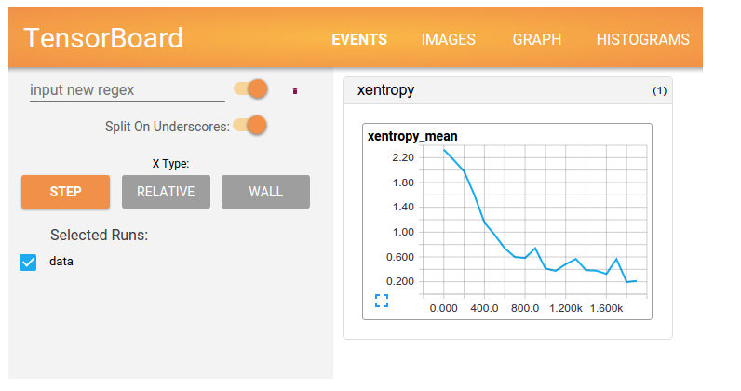
TensorBoard
Use TensorBoard to visualize your TensorFlow graph, plot quantitative metrics about the execution of your graph, and show additional data like images that pass through it.

Slide 8
TensorFlow Core tutorial
import tensorflow as tf
# access to all of TensorFlow's classes, methods, and symbols
TensorFlow Core programs as consisting of two discrete sections:
  Building the computational graph.
  Running the computational graph.
A computational graph is a series of TensorFlow operations arranged into a graph of nodes.
Graphs?
  Save computation (only run subgraphs that lead to the values you want to fetch)
  Break computation into small, differential pieces to facilitates auto-differentiation
  Facilitate distributed computation, spread the work across multiple CPUs, GPUs, or devices
  Many common machine learning models are commonly taught and visualized as directed graphs already
Notes:
Show the tutorial with jupyter

Slide 9

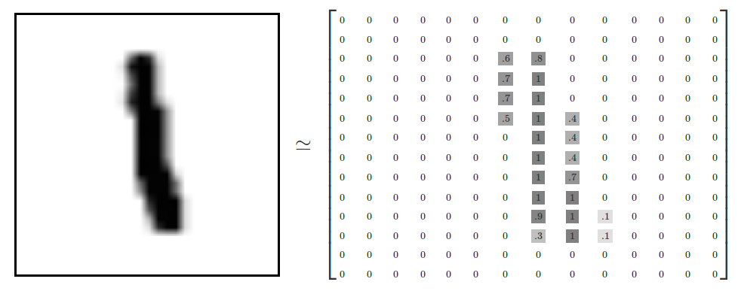
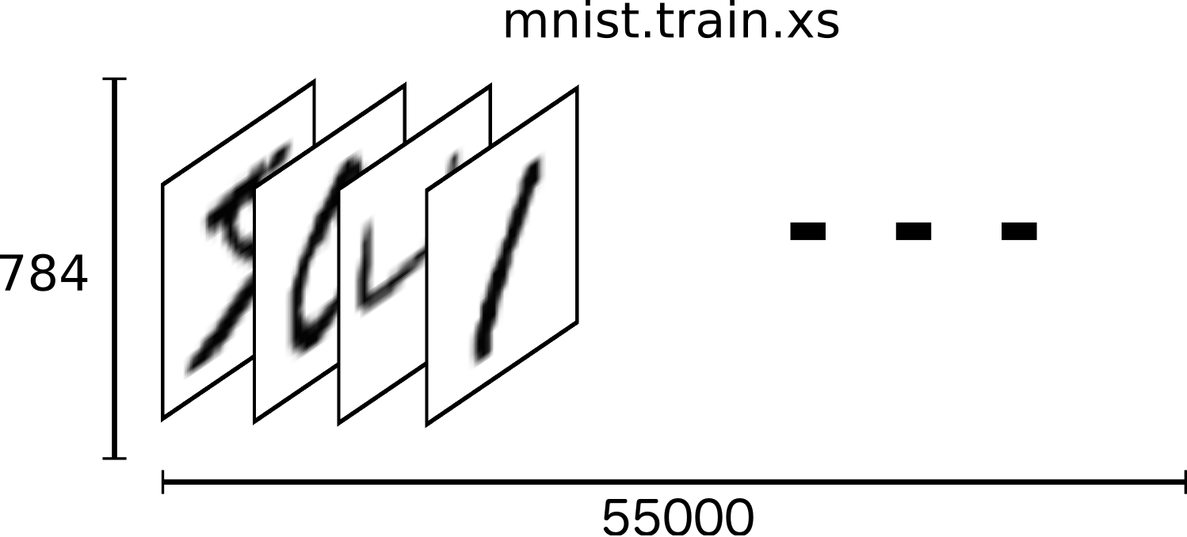
Simple try with TensorFlow
mnist.train.images is a tensor (an n-dimensional array) with a shape of [55000, 784].
The first dimension is an index into the list of images and the second dimension is the index for each pixel in each image. Each entry in the tensor is a pixel intensity between 0 and 1, for a particular pixel in a particular image.
Each image in MNIST has a corresponding label, a number between 0 and 9 representing the digit drawn in the image.

Slide 10
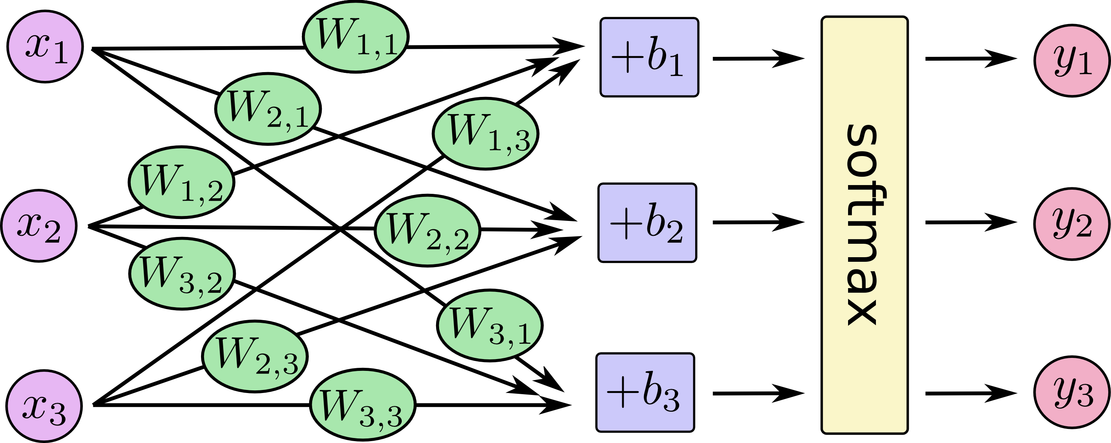
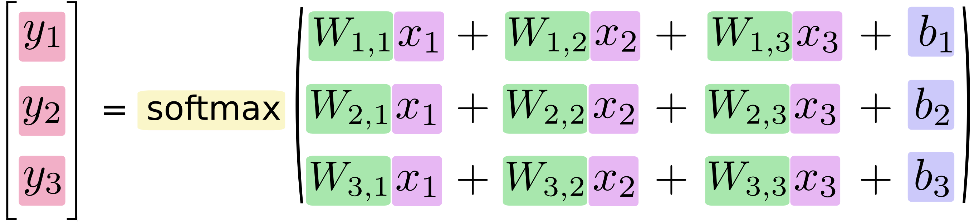
Here softmax is serving as an "activation" or "link" function,
Quick Installation!
See the Implementation Here!

Slide 11
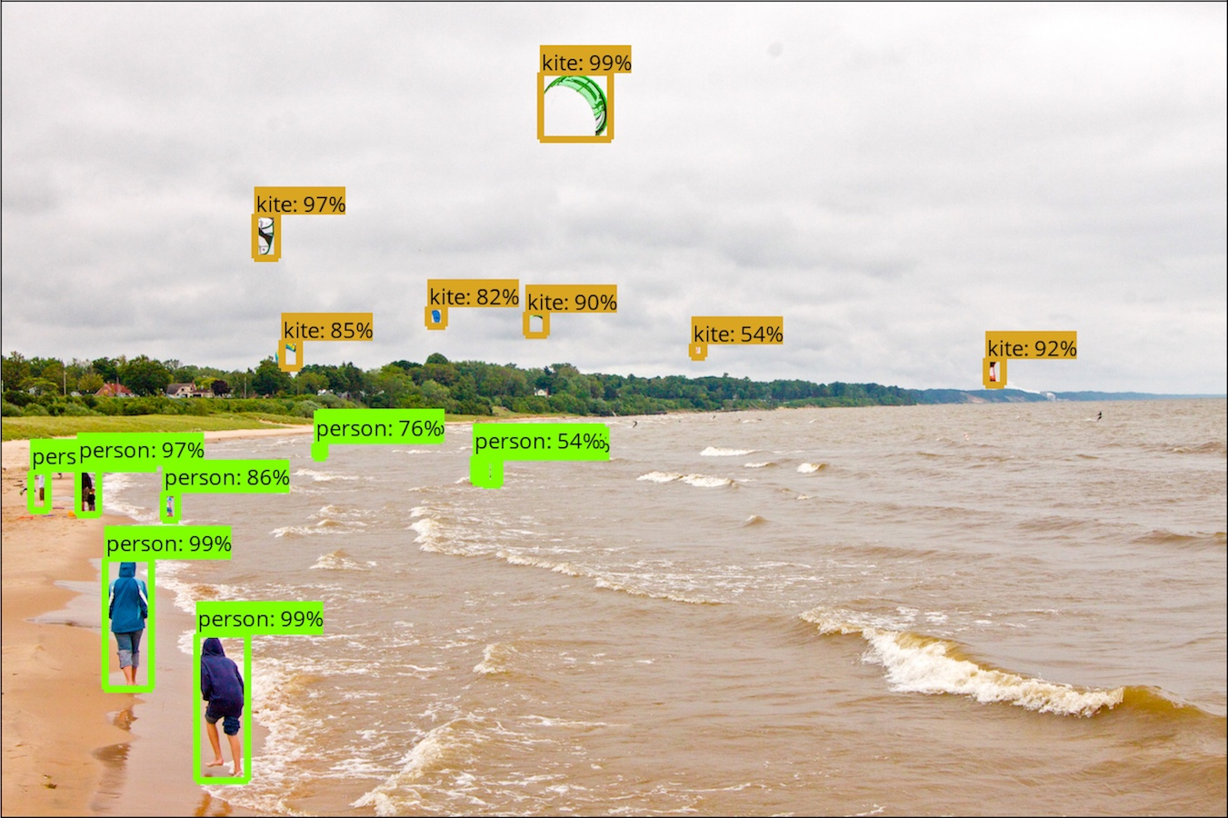
Latest API
The TensorFlow Object Detection API is an open source framework built on top of TensorFlow
https://github.com/tensorflow/models/tree/master/research/object_detection

Slide 12
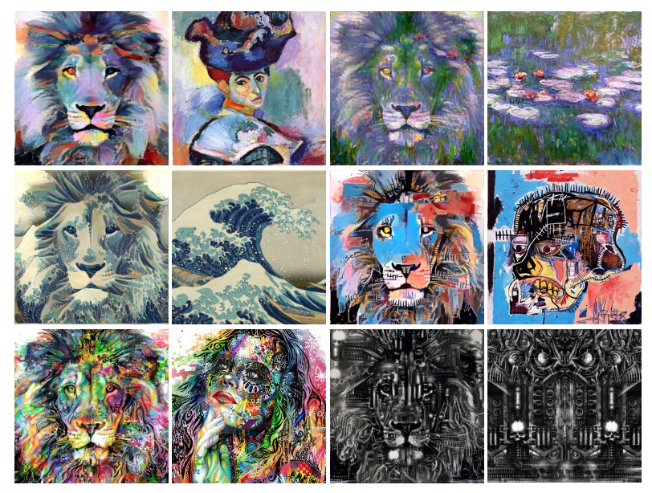
Artistic style transfer using TensorFlow
https://github.com/cysmith/neural-style-tf

Slide 13
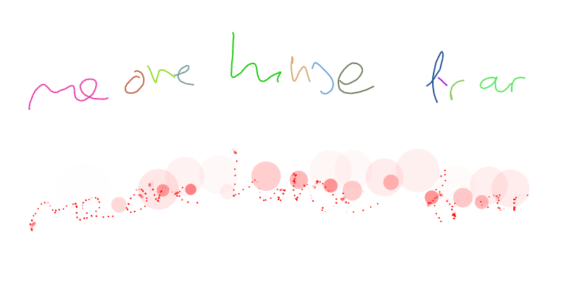
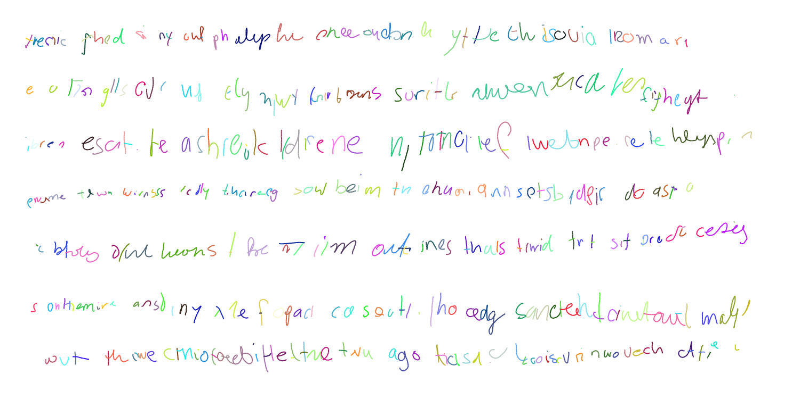
Generative Handwriting using TensorFlow
https://github.com/hardmaru/write-rnn-tensorflow

Slide 14

Questions?

